Slide 1


Vikram Ramakrishnan
May 7, 2024

Slide 2

Outline
Executive Summary
Introduction
Methodology
Results
Conclusion
Appendix

Slide 3
Executive Summary
Data published on SpaceX Falcon9 rocket launches was collected, wrangled, explored, and analyzed with the objective of identifying the factors influencing the success or failure of the first stage of the launch. Machine learning methodologies viz. logistic regression, support vector machine, decision tree, k-nearest neighbors were evaluated for predicting the outcome of the launch first stage based on the identified independent variables.
The Support Vector Machine (SVM) and K-Nearest Neighbors(KNN) appeared to score relatively higher on the test data, and amongst them, the KNN methodology appeared to score marginally higher on the mean of the cross-validated scores on the training data.

Slide 4
Introduction
Prior Falcon 9 rocket launch data published by SpaceX was analyzed to arrive at a mechanism to predict success of the first stage of future prospective launches, thereby enabling re-use of the first stage. Re-use of the first stage would result in significant cost savings, thereby improving the bottom line of any corporation involved in space exploration
Various popular classification models available were evaluated with the objective of arriving at the model that could best predict the probability of success of future launches and the optimal hyperparameters for each model evaluated based on the training data

Slide 5

Section 1

Slide 6
Methodology
Data for this analysis was collected from SpaceX published data and sourced via
Calling SpaceX APIs i.e. REST endpoints
Scraping web pages with tabular information having prior SpaceX rocket launch data
Necessary data wrangling was performed on the collected data for arriving at an outcome value (0 for failure and 1 for success) for each sample set (collection of variables) in the collected data
Exploratory Data Analysis (EDA) was performed after loading the dataset into a DB2 table using visualization and SQL. The objective was to try to find patterns and potential correlation between the different variables.
Further EDA was performed with visualization using scatter plots, bar plots generated using the python matplotlib library to study the relationship between the different variables.
Interactive visual analytics was performed using Folium and Plotly Dash libraries
Predictive analysis was performed on the collected data using classification models viz. Logistic Regression, SVM, Decision Tree, K-nearest neighbor via the GridSearchCV API provided as part of the SciKit Learn library

Slide 7
Data Collection
Data sets for the analysis and evaluation were sourced from
SpaceX APIs (REST based endpoints) loaded into pandas Dataframes
Scraped from tables in web pages (Wikipedia) and loaded into pandas Dataframes using the python BeautifulSoup library

Slide 8
Data Collection – SpaceX API
The starting point of the data collection process using the Spacex API was the JSON content at –
https://cf-courses-data.s3.us.cloud-object-storage.appdomain.cloud/IBM-DS0321EN-SkillsNetwork/datasets/API_call_spacex_api.json
JSON data from the above URL was loaded into a pandas dataframe. The data was cleaned and only a subset of the features were retained for further analysis
The loaded data was further enriched by making further REST API calls to specific endpoints for specific pieces of information
https://api.spacexdata.com/v4/cores/ (outcome, type of landing, if the core is reused, whether legs were used, landing pad used)
https://api.spacexdata.com/v4/launchpads/ (Name of launch site, latitude, longitude)
https://api.spacexdata.com/v4/rockets/ (Booster Version)
https://api.spacexdata.com/v4/payloads/ (Payload mass and orbit information)
The completed SpaceX API call notebook is available for review at https://github.com/vramakrishnan3/capstone/blob/main/jupyter-labs-spacex-data-collection-api_2.ipynb

Slide 9
Data Collection - Scraping
The starting point of the data collection process using web scraping was the html content at –
https://en.wikipedia.org/w/index.php?title=List_of_Falcon_9_and_Falcon_Heavy_launches&oldid=1027686922
The python requests library was used to make a GET HTTP request to the above URL, and the response was parsed using the BeautifulSoup parser library. The BeautifulSoup instance created was then used to build a python dictionary. This dictionary was in turn used to create a pandas dataframe. The dataframe would be used for further analysis and/or persisted.
The completed web scraping exercise notebook is available for review at –
https://github.com/vramakrishnan3/capstone/blob/main/jupyter-labs-webscraping.ipynb

Slide 10
Data Wrangling
The data collected and saved was re-loaded into a dataframe and some exploratory data analysis was done to determine the training label for the subsequent supervised learning efforts.
The number of missing values for each attribute/feature in the data was first determined
The number of launches by launch site was then viewed
The number of occurrences of each orbit type was then viewed
The number of distinct landing outcomes and their occurrence was then determined from the collected data
A new label column, called ‘class’, was determined from the landing outcome column for each launch. The column would have either a 0 value for an unsuccessful outcome or 1 for a successful outcome
The completed exercise for the above steps is available at -
https://github.com/vramakrishnan3/capstone/blob/main/labs-jupyter-spacex-Data%20wrangling.ipynb

Slide 11
EDA with Data Visualization
The collected data was analyzed to study the impact of different pairs of launch features on the launch outcome and its label. The following pairs of attributes were analyzed by plotting scatter plots
Payload mass, flight number
Launch site, flight number
Launch site, payload mass
Orbit type, flight number
Orbit type, payload
A bar plot was plotted to study the success rates by orbit type
A line chart was plotted to visualize the success rate of launches by year
The completed exercise for the above steps is available at –
https://github.com/vramakrishnan3/capstone/blob/main/edadataviz.ipynb

Slide 12
EDA with SQL
The data collected for SpaceX rocket launches was loaded into a DB2 database and the following SQLs were executed to get some useful insights on the data
Distinct names of the launch sites
Total payload mass of the boosters launched by NASA (CRS)
Average payload mass carried by booster version F9 v1.1
The date when the first successful landing outcome in ground pad was achieved
Boosters which have success in drone ship and have payload mass greater than 4000 but less than 6000
Total number of successful and unsuccessful launches
Booster versions which have carried the maximum payload
View month names,failure landing outcomes in drone ship, booster versions, launch sites for each month in the year 2015
Rank the count of landing outcomes between the date 2010-06-04 and 2017-03-20, in descending order
The completed notebook is available at https://github.com/vramakrishnan3/capstone/blob/main/jupyter-labs-eda-sql-coursera_sqllite.ipynb

Slide 13
Build an Interactive Map with Folium
Folium Markers (Marker Icons showing a label) and Folium Circles with Folium Popups were added to a folium map to show on a Map the location of the launch sites identified in the collected launch data, using the latitude and longitude information for each launch
For each launch site, using a Folium MarkerCluster marker icons were added for every launch record in the data, with the marker being marked in appropriate color to indicate a success of failure
The completed notebook is available at https://github.com/vramakrishnan3/capstone/blob/main/lab_jupyter_launch_site_location.ipynb

Slide 14
Build a Dashboard with Plotly Dash
An interactive dashboard was built using plotly dash modules, to help with the visualization of the following on the collected launch data from SpaceX –
A drop down was rendered consisting of the launch sites and including an ‘All’ option
A pie chart was rendered indicating the percentage of successful launches by site if the all option was chosen in the dropdown, and indicating the successful and failed launches for a particular site if a specific site was chosen
A slider component was rendered which would help filter the range of the payloads
A scatter plot was rendered to represent the correlation between the payload on the x-axis and the class (labelled launch outcome) on the y-axis with the points being colored by the booster version. The data used to render this scatter plot would be filtered to include only the records with payloads in the range chosen using the slider component above
Refer Section 4: Build a dashboard with plotly dash for screenshots of the above components

Slide 15
Predictive Analysis (Classification)
In order to evaluate the best performing classification model, the collected rocket launch data was first loaded into a pandas dataframe X, and the labelled launch outcome variable i.e., class, was loaded into a pandas series Y. Using the Scikit Learn test_train_split package from the model_selection module, the collected and loaded data was split into test and training sections, for model building and evaluation
For each of the models being evaluated viz. LogisticRegression, SVM, DecisionTreeClassifier, KNN (K-nearest neighbors), a specific GridSearchCV instance was constructed passing it the appropriate model instance, and hyperparameters for tuning. Each specific GridSearchCV instance was passed the training set data as part of the fitting process, and the best hyperparameters were determined, as also the mean cross validated score based on the training data
Each of the GridSearchCV instances above were passed the test data to evaluate the scores on the test data. Using the test data, the predicted values (of the ‘class’ label) were determined and the confusion matrix was also plotted to understand how accurate the predicted values were compared to the actual value
The completed notebook covering the above steps is available for review at
https://github.com/vramakrishnan3/capstone/blob/main/SpaceX_Machine%20Learning%20Prediction_Part_5_2.ipynb

Slide 16
Results
Please find screenshots for the exploratory data analysis results with explanation in “Section 2: Insights drawn from EDA”
Screenshots for the Interactive analytics dashboard built can be found in “Section 4: Build a Dashboard with Plotly Dash”
Predictive analysis results is presented with screenshots in “Section 5: Predictive Analysis (Classification)”

Slide 17

Section 2

Slide 18
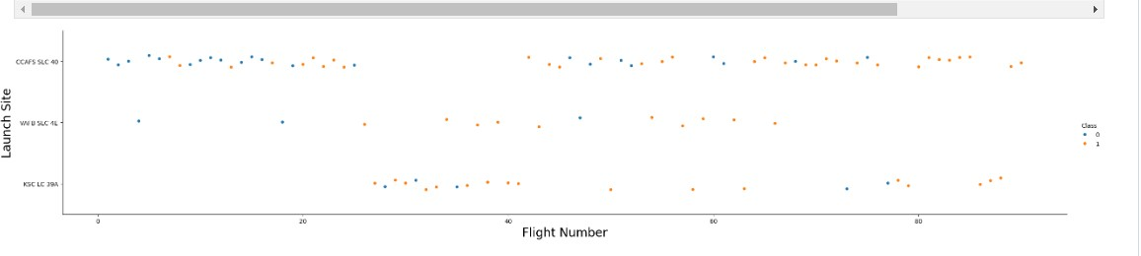
Flight Number vs. Launch Site
Shown above is a scatter plot of Flight Number vs. Launch Site, plotted as part of the exploratory data analysis on the SpaceX launch data collected
The launch site CCAFS SLC 40 appears to show a marginally higher success rate for the launch and over a high base (higher number of overall launches)

Slide 19
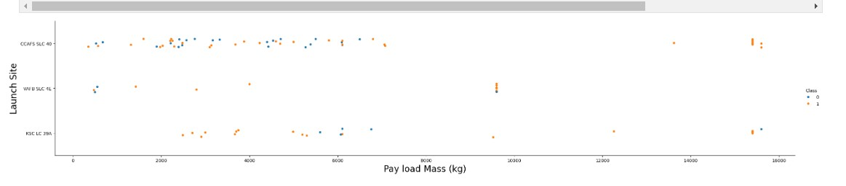
Payload vs. Launch Site
Shown above is the scatter plot of Payload vs. Launch Site plotted as part of the exploratory data analysis exercise to see the correlation between these 2 features and the launch outcome.
One thing that becomes evident is that for the VAFB-SLC lunch site there are no launches for payloads higher than 10000

Slide 20
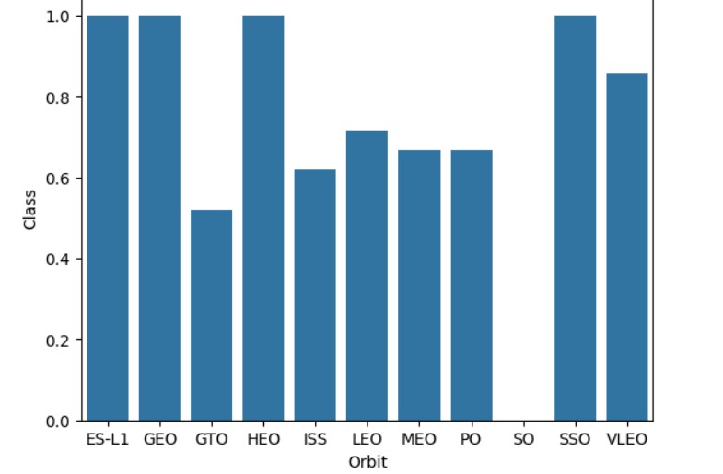
Success Rate vs. Orbit Type
Shown here is a bar chart depicting the observed success rate of each orbit type in the collected data, plotted as part of the exploratory data analysis exercise
The SSO and LEO orbit types showed a very high success rate spanning multiple launches (>5 each). The ES-L1 and GEO orbit types had 1 launch each which were successful (Evident from the next slide)

Slide 21
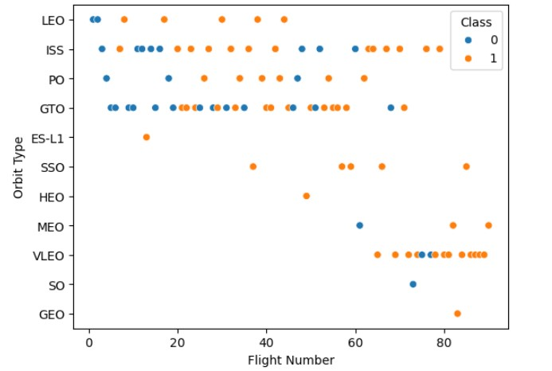
Flight Number vs. Orbit Type
Shown here is a scatter point chart of Flight number vs. Orbit type depicting the correlation between the Orbit Type and Flight Number and the success/failure classification label in the collected data, plotted as part of the exploratory data analysis exercise

Slide 22
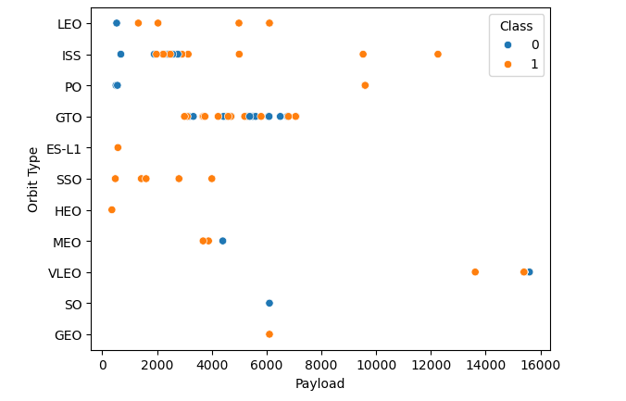
Payload vs. Orbit Type
Shown is a scatter plot of the Payload against the Orbit Type based on the samples in the collected and cleaned rocket launch data
For larger payloads samples are available only for the ISS, PO and VLEO orbit types and are showing just one failed outcome. The SSO orbit type is showing all success outcomes

Slide 23
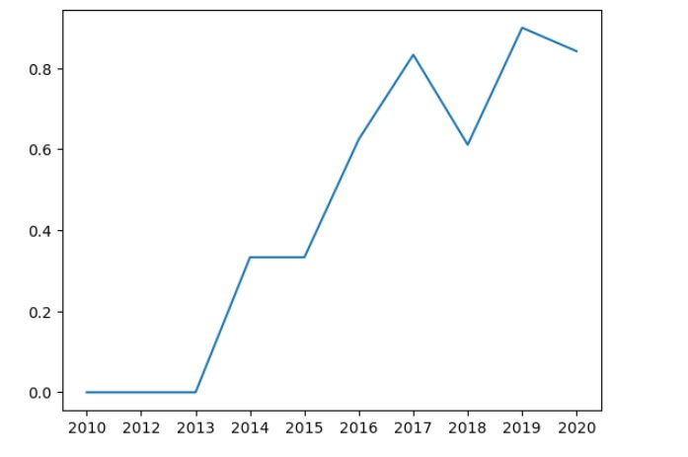
Launch Success Yearly Trend
Shown here is a line chart of yearly average success rate of rocket launches of the Falcon9 launches based on samples in the collected data and plotted as part of the EDA exercise
The success rate is shown to have been improving from 2013 till 2020

Slide 24
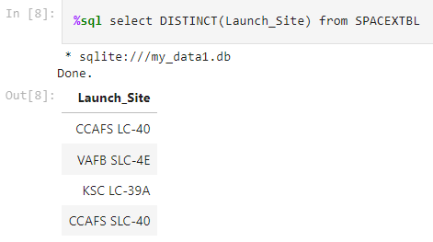
All Launch Site Names
As part of the EDA (Exploratory Data Analysis) using SQL as part of exercise https://github.com/vramakrishnan3/capstone/blob/main/jupyter-labs-eda-sql-coursera_sqllite.ipynb , the rocket launch data collected was loaded into a DB2 relation table called SPACEXTBL and the SQL depicted was executed to arrive at the distinct launch sites in the samples

Slide 25
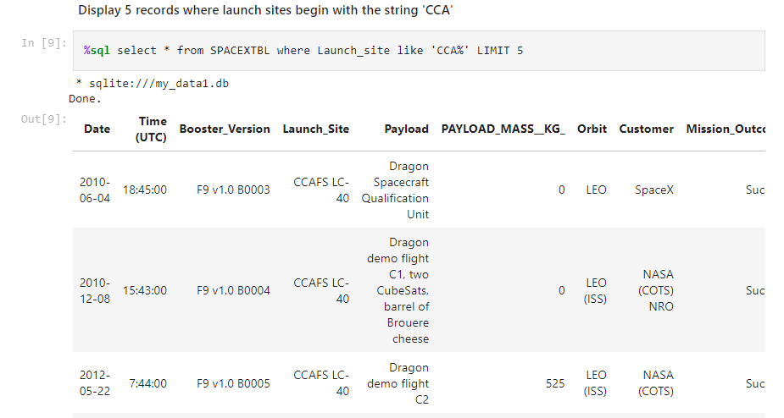
Launch Site Names Begin with 'CCA'
The depicted SQL was used to find 5 records where launch sites begin with `CCA`
Refer https://github.com/vramakrishnan3/capstone/blob/main/jupyter-labs-eda-sql-coursera_sqllite.ipynb

Slide 26
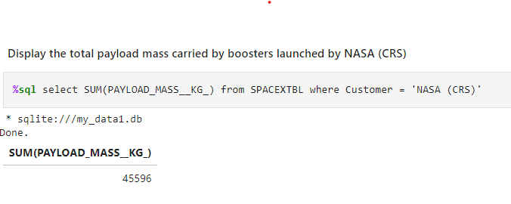
Total Payload Mass
The depicted SQL was used to calculate the total payload carried by boosters from NASA. Refer the exercise at https://github.com/vramakrishnan3/capstone/blob/main/jupyter-labs-eda-sql-coursera_sqllite.ipynb

Slide 27
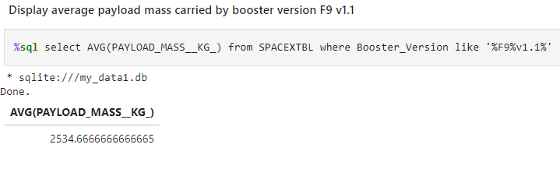
Average Payload Mass by F9 v1.1
The depicted SQL was used to calculate the average payload mass carried by booster version F9 v1.1
Refer https://github.com/vramakrishnan3/capstone/blob/main/jupyter-labs-eda-sql-coursera_sqllite.ipynb

Slide 28
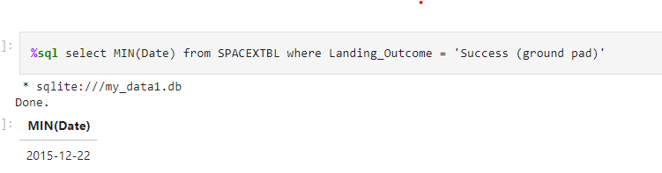
First Successful Ground Landing Date
The SQL shown here was used to find the dates of the first successful landing outcome on ground pad ( Refer https://github.com/vramakrishnan3/capstone/blob/main/jupyter-labs-eda-sql-coursera_sqllite.ipynb )

Slide 29
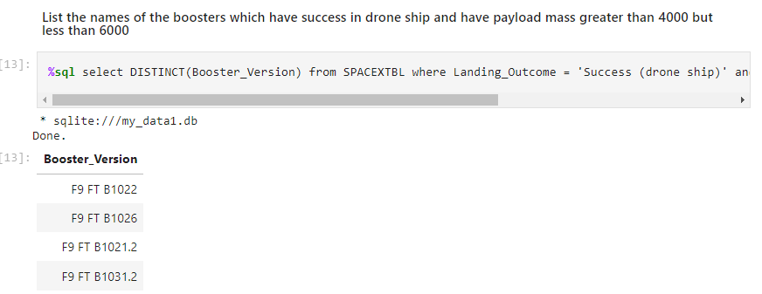
Successful Drone Ship Landing with Payload between 4000 and 6000
The SQL below was used to list the names of boosters which have successfully landed on drone ship and had payload mass greater than 4000 but less than 6000 ( Refer Task 6 of https://github.com/vramakrishnan3/capstone/blob/main/jupyter-labs-eda-sql-coursera_sqllite.ipynb )
%sql select DISTINCT(Booster_Version) from SPACEXTBL where Landing_Outcome = 'Success (drone ship)' and PAYLOAD_MASS__KG_ > 4000 and PAYLOAD_MASS__KG_ < 6000

Slide 30
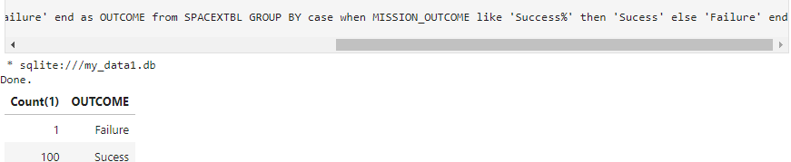
Total Number of Successful and Failure Mission Outcomes
The SQL below was used to calculate the total number of successful and failure mission outcomes. Refer Task 7 at https://github.com/vramakrishnan3/capstone/blob/main/jupyter-labs-eda-sql-coursera_sqllite.ipynb
%sql select Count(1), case when MISSION_OUTCOME like 'Success%' then 'Sucess' else 'Failure' end as OUTCOME from SPACEXTBL GROUP BY case when MISSION_OUTCOME like 'Success%' then 'Sucess' else 'Failure' end

Slide 31
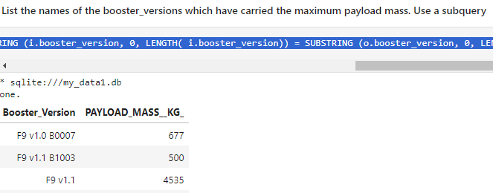
Boosters Carried Maximum Payload
The SQL below was used to list the names of the boosters which have carried the maximum payload mass. Refer the completed exercise Task 8 at https://github.com/vramakrishnan3/capstone/blob/main/jupyter-labs-eda-sql-coursera_sqllite.ipynb
%sql select booster_version, PAYLOAD_MASS__KG_ from SPACEXTBL o where PAYLOAD_MASS__KG_ = (select max(i.PAYLOAD_MASS__KG_) from SPACEXTBL i where SUBSTRING (i.booster_version, 0, LENGTH( i.booster_version)) = SUBSTRING (o.booster_version, 0, LENGTH( o.booster_version) ) )

Slide 32
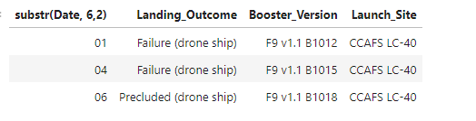
2015 Launch Records
The SQL below lists the failed landing_outcomes in drone ship, their booster versions, and launch site names in the year 2015 ( Task 9 of EDA exercise at https://github.com/vramakrishnan3/capstone/blob/main/jupyter-labs-eda-sql-coursera_sqllite.ipynb )
%sql select substr(Date, 6,2), landing_outcome, booster_version, launch_site from SPACEXTBL where Landing_Outcome in ('Failure (drone ship)','Precluded (drone ship)') and substr(Date,0,5) = '2015'

Slide 33
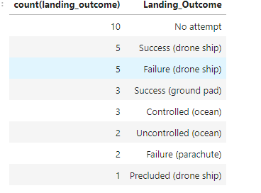
Rank Landing Outcomes Between 2010-06-04 and 2017-03-20
The SQL below ranks the count of landing outcomes (such as Failure (drone ship) or Success (ground pad)) between the date 2010-06-04 and 2017-03-20, in descending order and was part of the EDA exercise at https://github.com/vramakrishnan3/capstone/blob/main/jupyter-labs-eda-sql-coursera_sqllite.ipynb (Task 10)
%sql select count(landing_outcome), landing_outcome from SPACEXTBL where date(substr(Date,0,5) || '-' || substr(Date, 6,2) || '-' || substr(Date, 9, 2)) between DATE('2010-06-04') and DATE('2017-03-20') group by landing_outcome order by count(landing_outcome) desc

Slide 34

Section 3

Slide 35
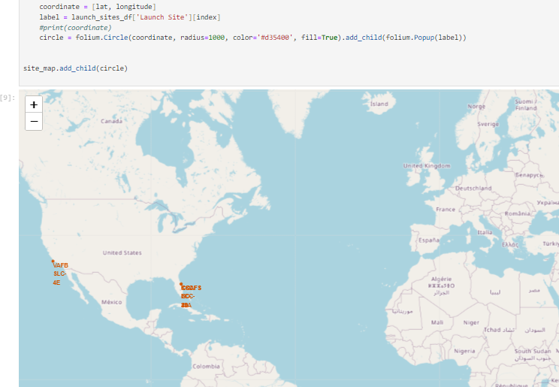
Launch Sites Analysis and Representation
From the rocket launch data collected, the launch site name, latitude and longitude was used to mark the launch sites on a map using the Folium python library (Refer notebook at https://github.com/vramakrishnan3/capstone/blob/main/lab_jupyter_launch_site_location.ipynb )
A screenshot of the generated map is show here

Slide 36
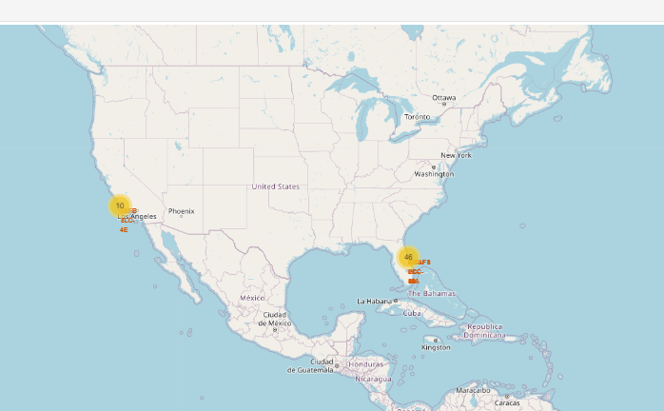
Representing launch outcomes on a map
From the rocket launch data collected, the launch site name, latitude and longitude was used, along with the launch outcomes for the site to mark in color, the launch outcomes and their number, on a map using the Folium python library (Refer notebook at https://github.com/vramakrishnan3/capstone/blob/main/lab_jupyter_launch_site_location.ipynb )
The Marker, Icon and MarkerCluster folium components were used. A screenshot of the generated map is show here.

Slide 37
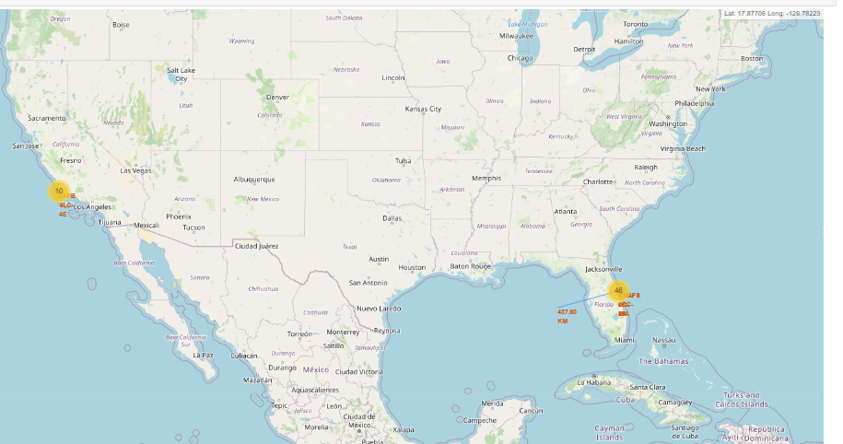
Representing, Analyzing Proximities to Launch Sites
The generated folium map was analyzed and distances of some proximities of each launch site (such as railway, highway, coastline) was displayed. A screenshot is shown here depicting a line drawn from a proximity to a launch site, using a Folium PolyLine component

Slide 38

Section 4

Slide 39
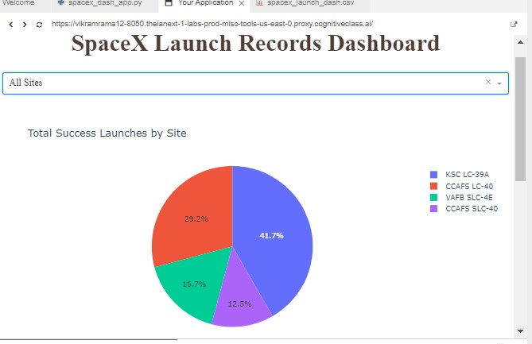
Analyzing Launch Success by Site
Using the plotly and dash libraries, a dashboard was built where the Success rate by launch site could be visualized based on the collected launch data
Shown here is a generated screenshot with a pie chart depicting the percentage of successful launches by site (When ‘All Sites’ is chosen from the dropdown on the interactive dashboard built)

Slide 40
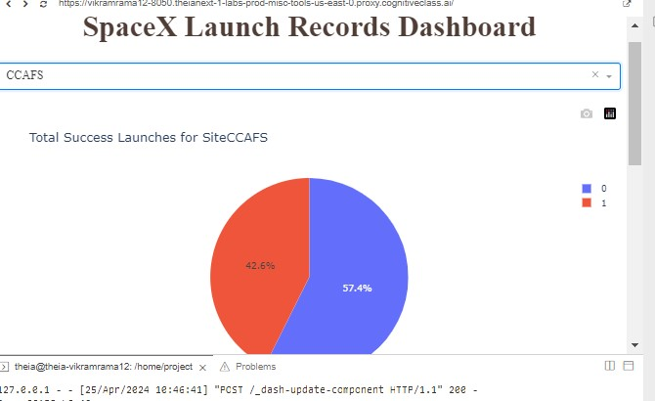
Analyzing Launch Success by Site (Continued)
Depicted here is the pie chart that appeared on the interactive dashboard when a specific launch site was selected. It depicts the relative success and failure launch percentages for the chosen site

Slide 41
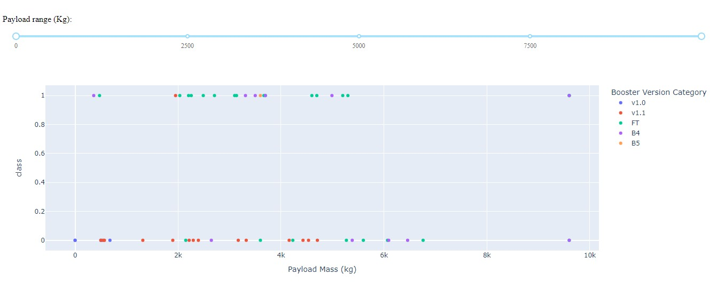
Analyzing Payload Correlation with Launch Outcome
Shown below is a screenshot of the scatter plot showing the variation of the launch outcome by payload. As can be seen here, there is a slider component that can be used to filter by payload range. The scatter plot and slider were placed on an interactive dashboard and the variation of launch outcome with payload and broken up by Booster Version was studied

Slide 42

Section 5

Slide 43
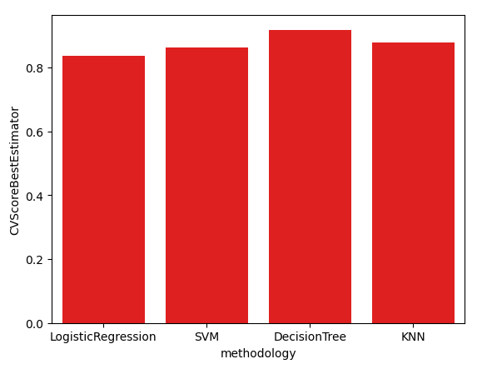
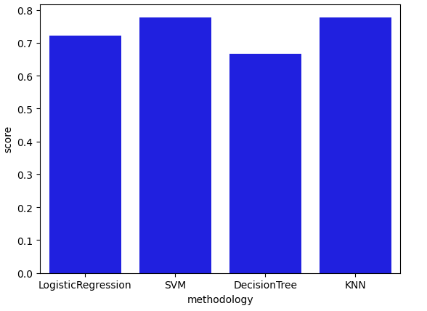
Classification Accuracy
Based on the predictive classification model analysis evaluation exercise at https://github.com/vramakrishnan3/capstone/blob/main/SpaceX_Machine%20Learning%20Prediction_Part_5_2.ipynb shown above are some accuracy indicators. The complete data collected for rocket launches was split into training (80%) and test (20%) segments. Shown on the left above is the mean cross validated score based on the training data for 4 different popular classification models viz. Logistic Regression, Support Vector Machine (SVM), Decision Tree Classifier, and K-nearest neighbors (KNN)
Shown on the top right are the scores determined on the test data for the same 4 classification models. This reflects the accuracy of the models’ performance on the test data. As is evident, KNN and SVM had a slightly higher accuracy than the other 2

Slide 44
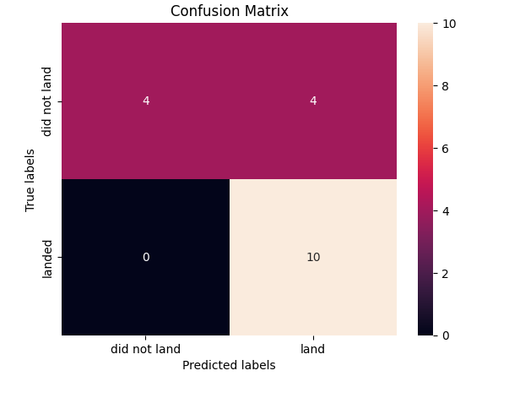
Confusion Matrix
Shown here is the confusion matrix of K-nearest Neighbors model (which appeared to show the best accuracy) derived based on the test data (18 samples). As shown, there are 4 inaccurate predictions

Slide 45
Conclusions
Significant cost savings should ensue through the re-use of the first stage in future rocket launches, thereby improving the bottom line for the company
Data was collected from SpaceX on their rocket launches was first wrangled to determine a classification label for each launch. The launch data was then analyzed along with the launch outcome. The performance of 4 popular classification models was analyzed
Based on the observed performance, the Support Vector Machine (SVM) and K-Nearest Neighbors(KNN) appeared to score relatively higher on the test data with 18 samples and borne out through the confusion matrices
The KNN methodology appeared to score marginally higher on the mean of the cross-validated scores on the training data

Slide 46
Appendix
The following code snippets were used to perform the activities of data collection, data wrangling, EDA, interactive data analysis and predictive analytics
https://github.com/vramakrishnan3/capstone/blob/main/datacollection_with_api_and_webscraping.py
https://github.com/vramakrishnan3/capstone/blob/main/datawrangling.py
https://github.com/vramakrishnan3/capstone/blob/main/eda_with_sql.py
https://github.com/vramakrishnan3/capstone/blob/main/eda_plotly_dash.py
https://github.com/vramakrishnan3/capstone/blob/main/eda_with_matplotlib_pandas_seaborn.py
https://github.com/vramakrishnan3/capstone/blob/main/eda_folium.py
https://github.com/vramakrishnan3/capstone/blob/main/falcon9_ml_predict.py

Slide 47


